Slide 1
Companies Leaving or Staying in Russia Following Invasion of Ukraine
Travis Lindeman

Slide 2
Agenda
Stakeholder Interest
Data of Interest
Compare Company Activity following invasion of Ukraine
Type of Industry
Country of Origin
Scale Comparison
Way Forward

Slide 3
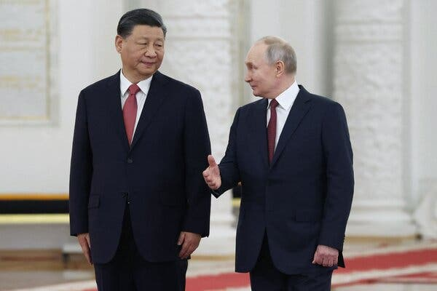
Stakeholder Interest
Evaluate whether specific industries are unable/unlikely to divest
Inform future negotiation strategies
Assess significant disparities to determine vulnerable companies for sanctions strategies
Notes:
Image from Sputnik, via Agence France Presse and accessed from The New York Times JUL 11th, 2023 at: https://www.nytimes.com/2023/07/06/opinion/xi-putin-relationship-china.html

Slide 4
Data of Interest
Company Name
1581 Companies
Actions taken since the Invasion
Company Industry:
12 categories
Country of Origin:
67 represented
Grade:
A, B, C, D, F
Name | Action | Industry | Country | Grade
China Mobile | Business as usual | Communications | China | F
Guess | Business as usual | Consumer Discretionary | United States | F
TEPCO | Continues purchasing Russian Gas | Energy | Japan | F
WeWork | Planning Divestment of Russian Operations | Real Estate | United States | A
Uber | Divest Yandex Partnership | Information Technology | United States | A
Data aggregated by researchers at the Yale Chief Executive Leadership Institute
Notes:
Action & Letter grade are subjective measures.

Slide 5
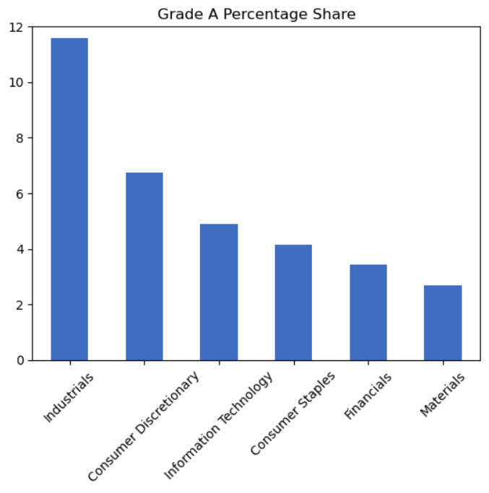
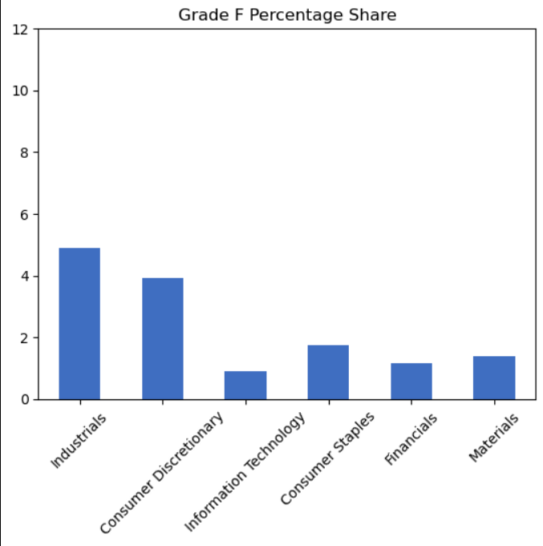
Comparison by Industry: Biggest Six Industries
Industry comparison does not show significant differences

Slide 6
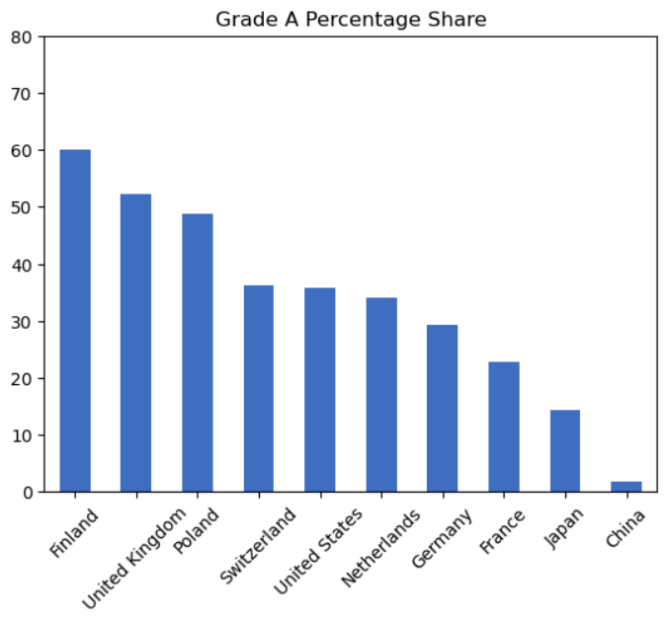
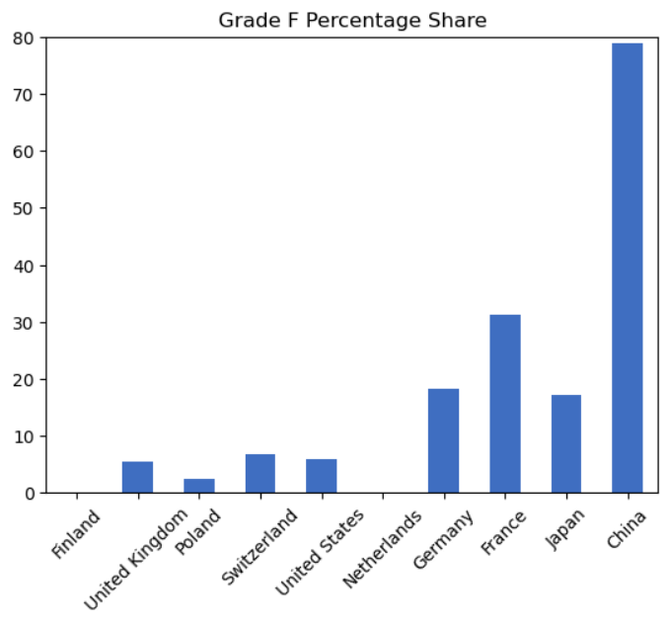
Comparison by Country of Origin: 10 Countries with the Most Companies in Russia
Reflected by “no-limit” partnership between China & Russia.
Reflected by President Macron’s statement about “getting caught up in crises that are not ours” and “strategic autonomy.”
Geopolitical positions correlate with company operations in Russia

Slide 7
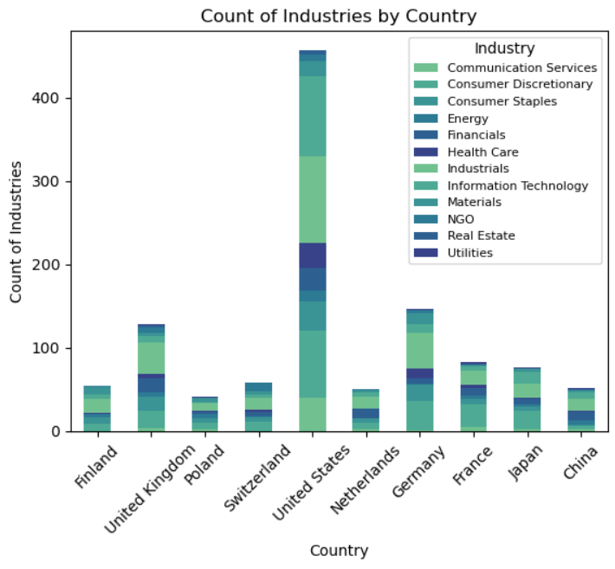
Scale Comparison with Total of all Companies
F Grades account for 41 Chinese, 26 French, and 27 U.S. companies
Notes:
China may be under represented. However, Finland and China have almost the same number of companies and are opposites in their received grades.

Slide 8
Future Project Plans
Comparison by “Global South” countries: Brazil, South Africa, Turkiye, Indonesia, China to see if the “unaligned global south” is less interested in divestment
Perhaps a scatter plot which shows the number of each letter grade by the 10 most represented countries in the study
See if there is a difference between state-owned enterprises specifically, though this requires a more individuated look at each company
Could group A & B and D & F to show greater aggregation

Slide 9
Contact and Data Links
Contact Info:
Travis Lindeman
tralinde@gmail.com
Repository link:
https://github.com/tralinde/companies_in_russia
Dataset link:
https://www.kaggle.com/datasets/vadimtynchenko/list-of-companies-leaving-or-staying-in-russia

